Slide 1
Cloud Identification
Atmospheric Sciences 101
Autumn 2026

Slide 2
Cloud Identification
Provides great insights into what is occurring in the atmosphere
Illustrates basic physics of the atmosphere.
Useful knowledge: gives one practical forecasting skill.

Slide 3

What are clouds made of?
H₂O droplets or ice crystals (or both)
Clouds form as air cools to saturation. Two major ways this can happen:
  Upward motion (most clouds). Air expands and cools as it rises (called adiabatic cooling)
  Cooling by contact with a cool surface.

Slide 4
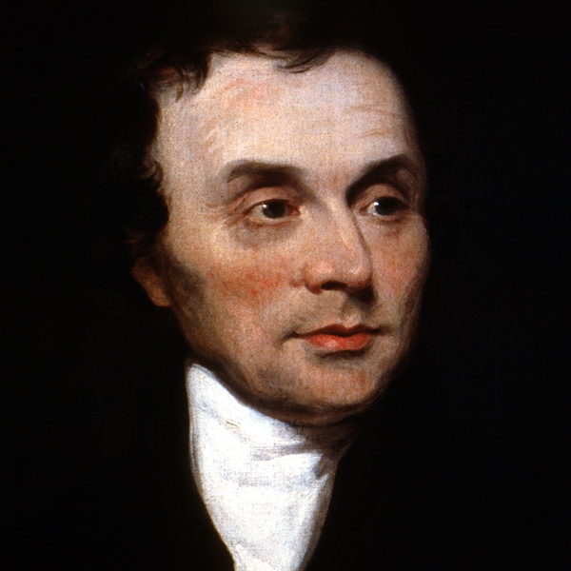
Cloud Classification
Current system developed in the early 1800s by the French naturalist Lamarck and Englishman Luke Howard
Divided clouds into 4 basic types based on their appearance
Also classified by their heights.

Slide 5
Major Cloud Types
Stratus: layer or sheet-like clouds
Cirrus: thin, wispy clouds
Cumulus: puffy cotton-ball like clouds. Some have great vertical development
Nimbus: precipitating clouds

Slide 6
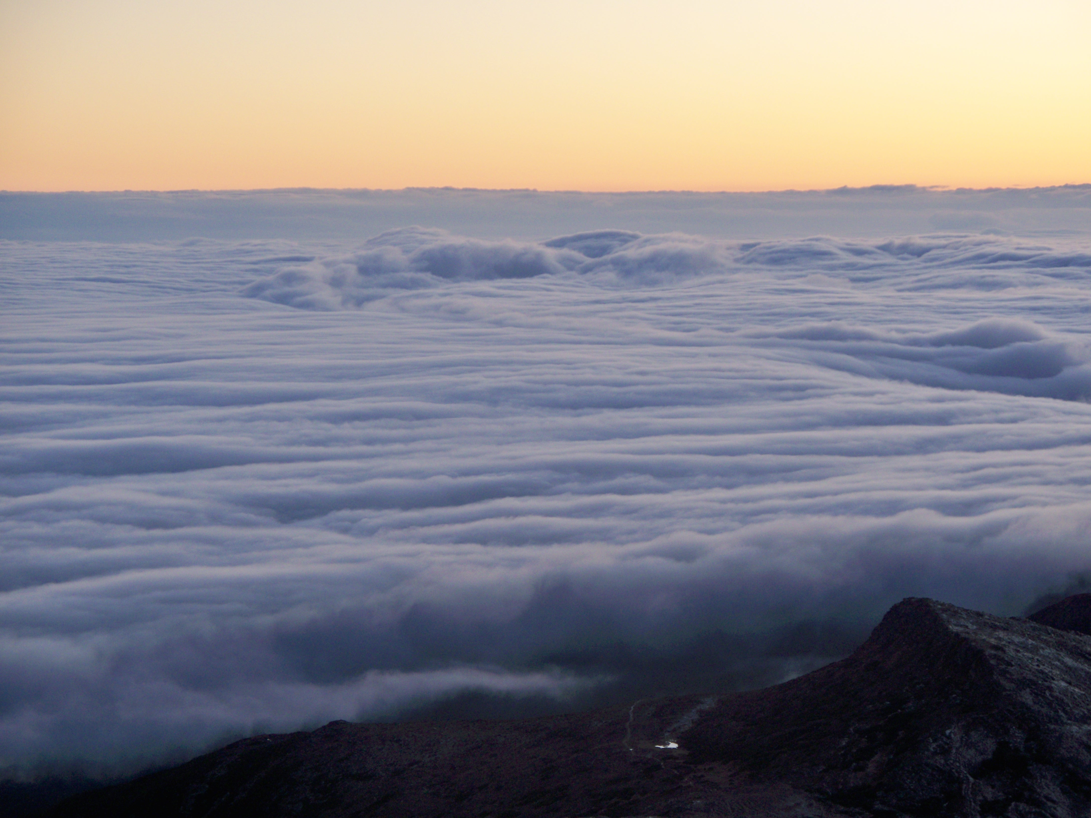
Stratus or layered clouds

Slide 7
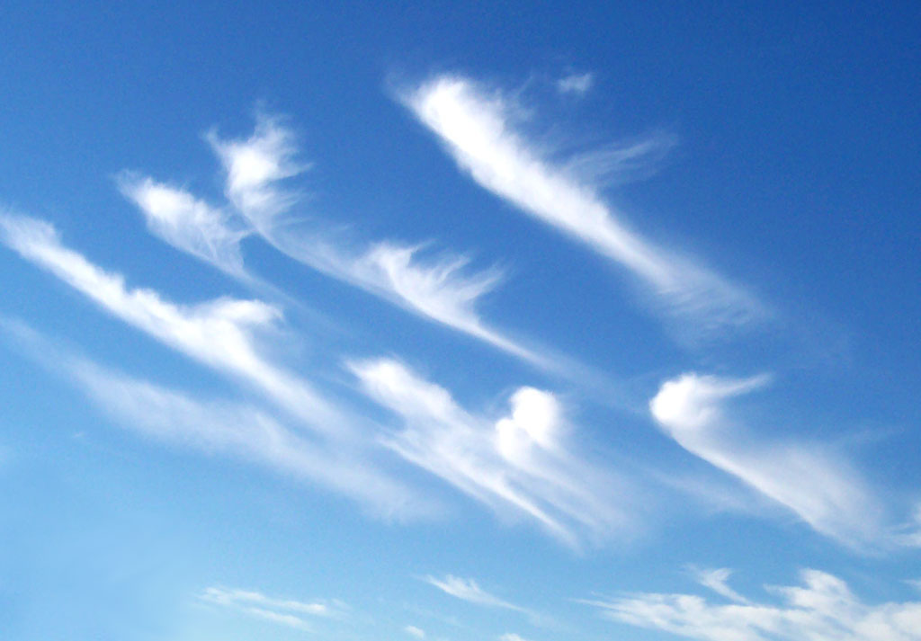
Cirrus: wispy ice clouds

Slide 8
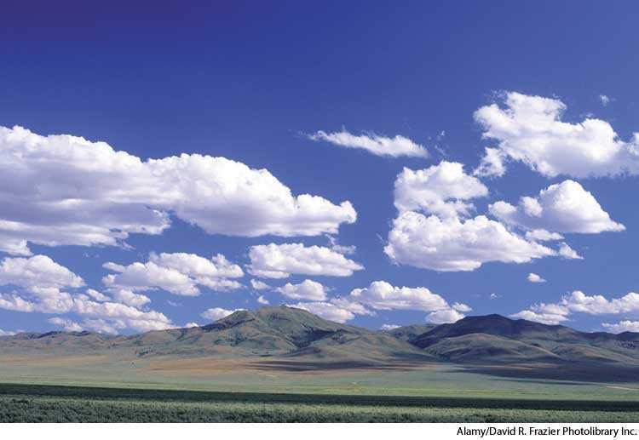
Cumulus: divided into elements, cotton-puff shape

Slide 9
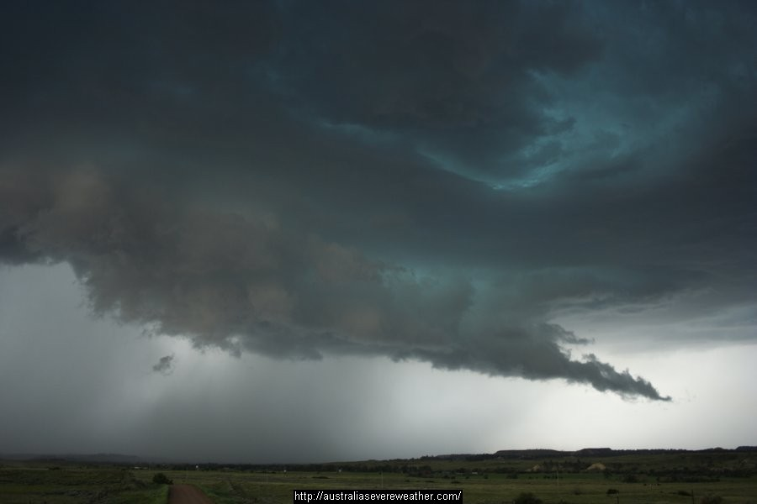
Nimbus: precipitating

Slide 10
Cloud Heights
Clouds divided into high, medium, and low clouds
High: more than 7 km above surface, often uses prefix ”cirro”
Middle: 2-7 km, prefix “alto”
Low: < 2 km

Slide 11

Building cloud names
Cirrostratus: a high ice cloud in a layer
Altocumulus: middle level cumulus
Cumulonimbus: precipitating cumulus
Nimbostratus: a layered cloud that is precipitating

Slide 12
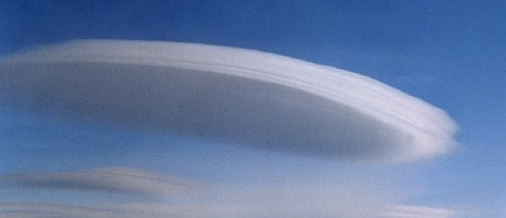
Even More
Several additional suffixes. Some examples:
  Lenticularis- lens-shaped clouds
  Castellanus- turret shaped or castle like
  Fractus: ragged, broken appearance
Altocumulus lenticularis

Slide 13
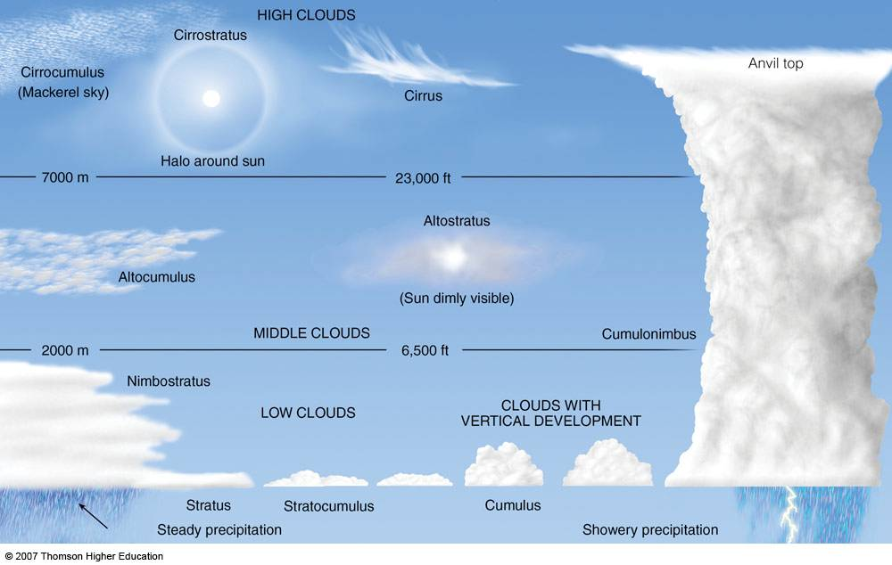
Let’s Review Major Cloud Types

Slide 14
High Clouds (higher than 7 km)
Made of ice crystals
Diffuse edges
Cirrus, cirrostratus, and cirrocumulus

Slide 15

Note the fallstreaks:
Falling ice crystals swept horizontally by the wind
Cirrus

Slide 16
Cirrus with fallstreaks, also called mare’s tales

Slide 17
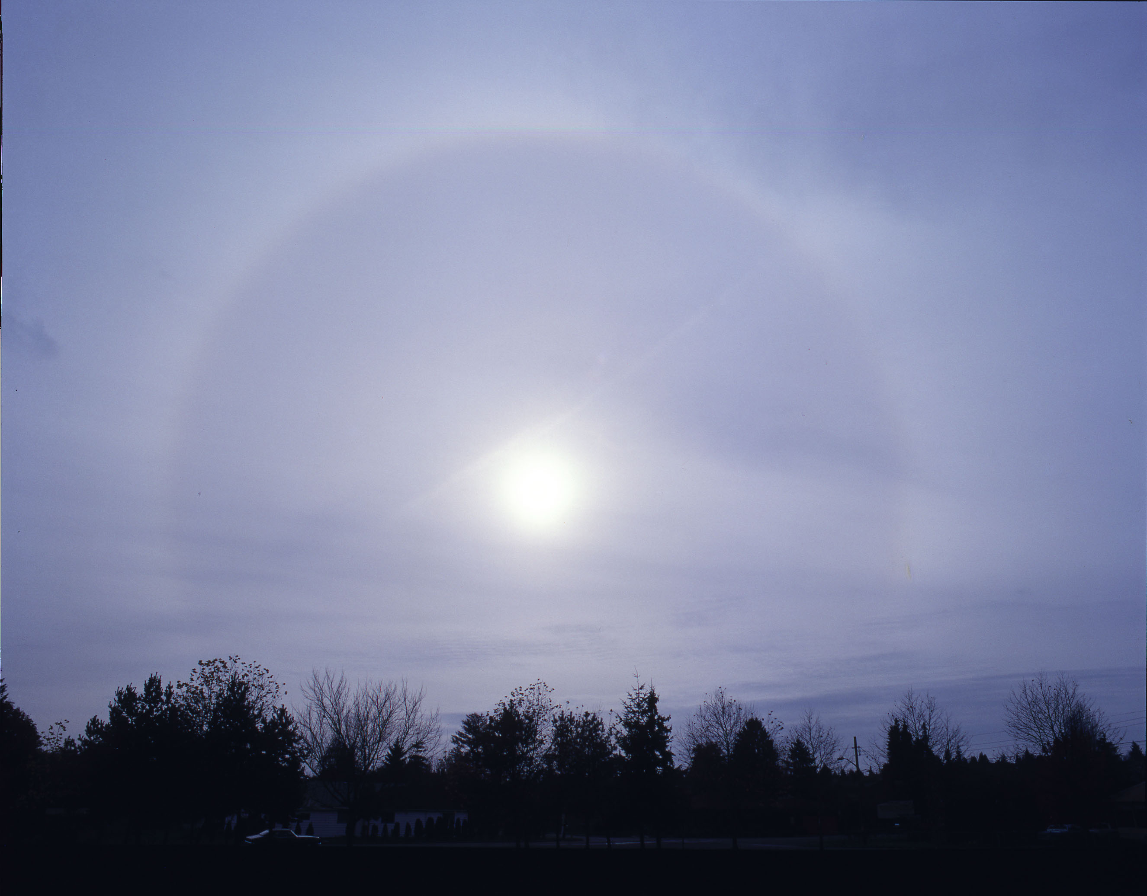
Cirrostratus (note halo around the sun)
A relatively uniform layer of ice clouds

Slide 18
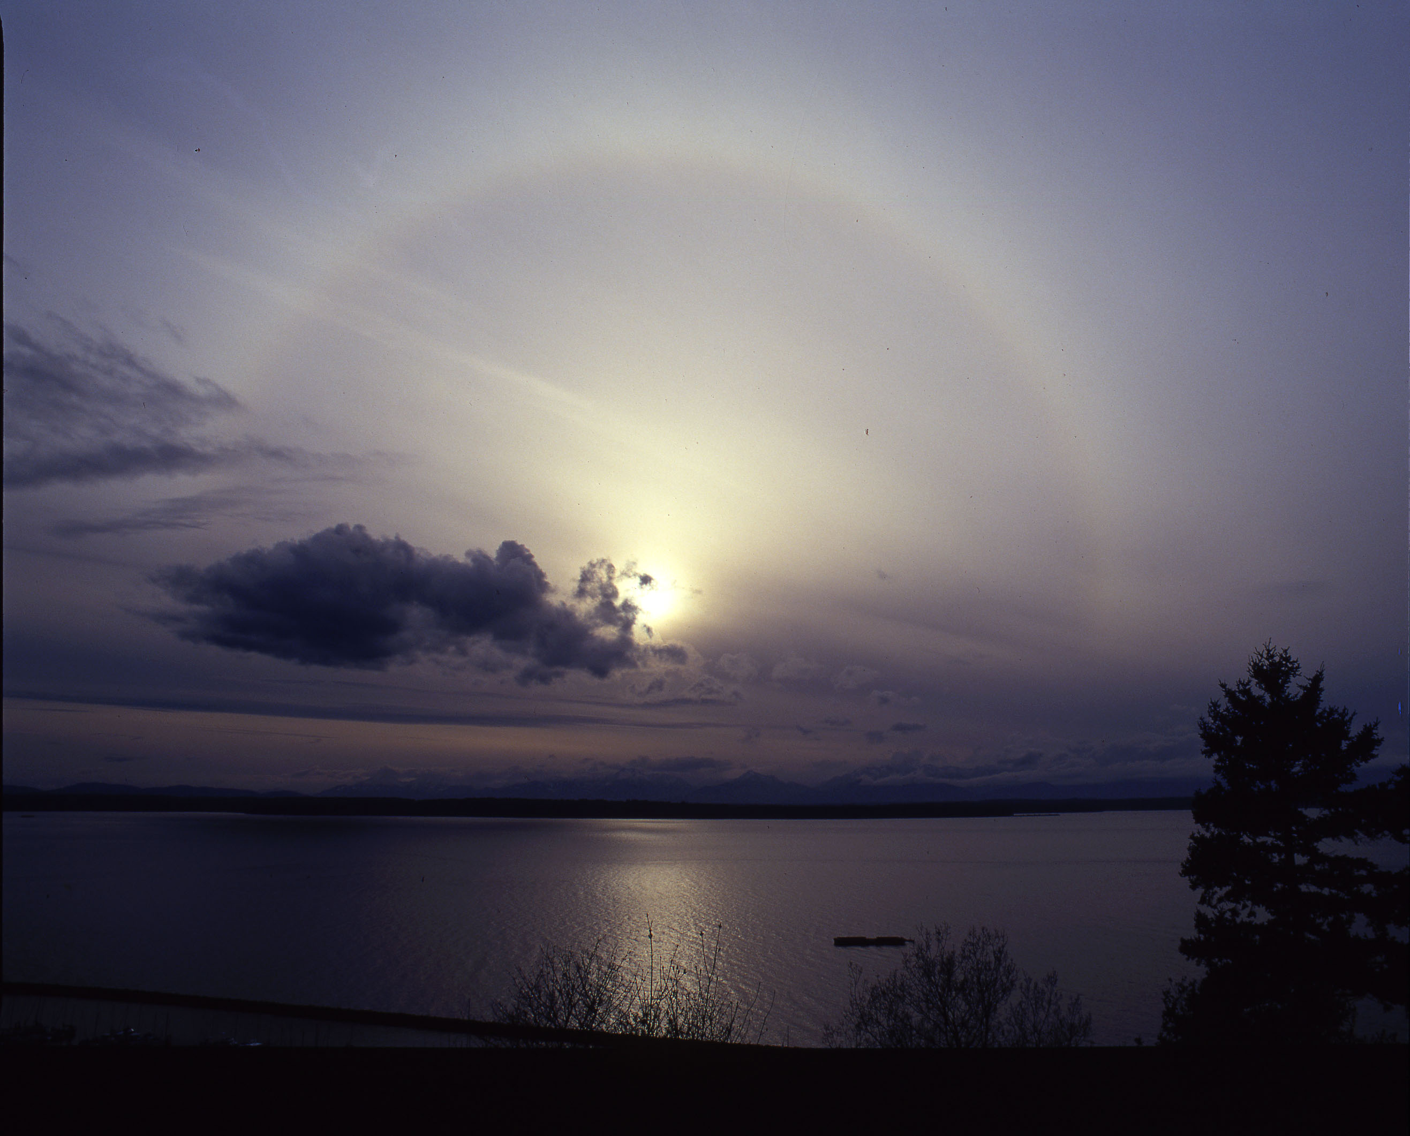

Slide 19

Cirrocumulus
High ice clouds structured into elements

Slide 20
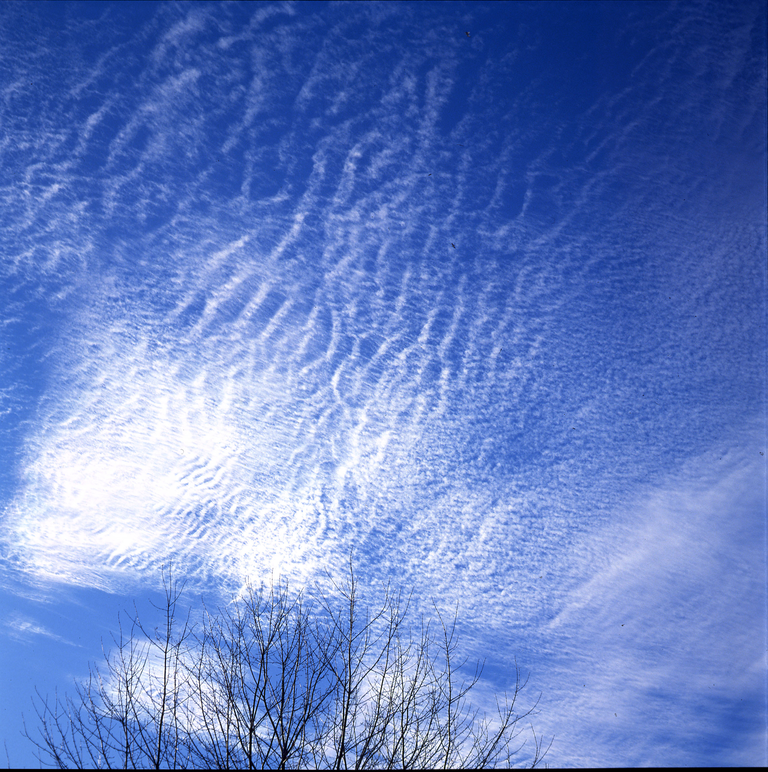
Cirrocumulus

Slide 21
Middle-Level Clouds (2-7km)
Water or ice clouds
Or a mixture of the two

Slide 22
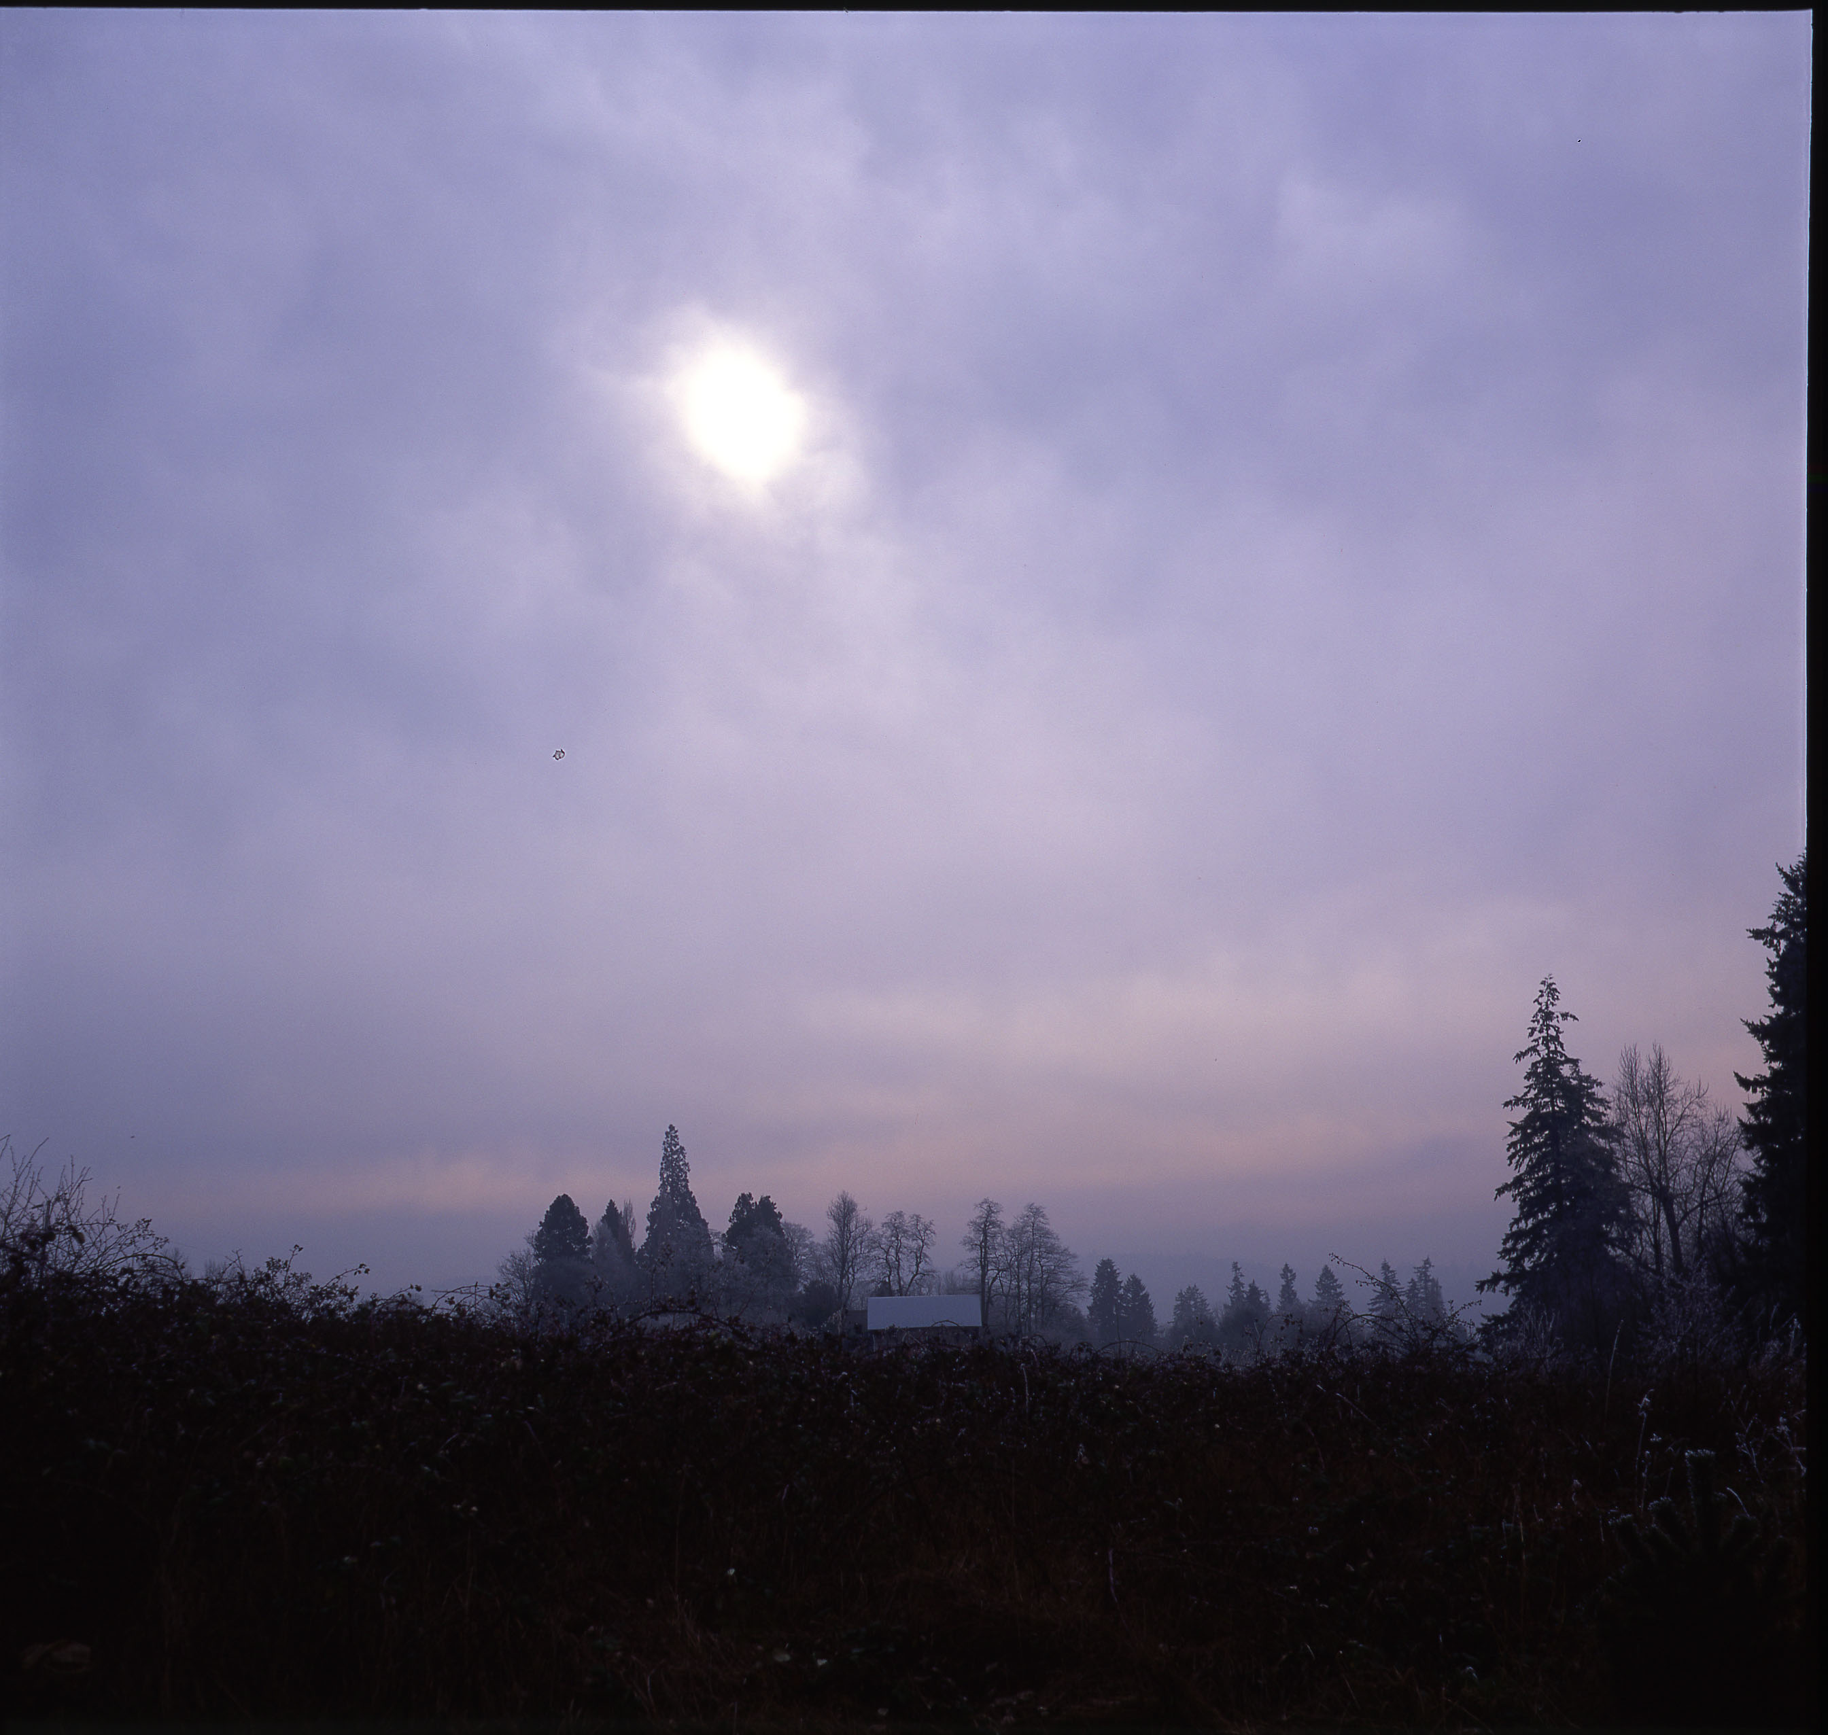
Altostratus (watery sun)

Slide 23
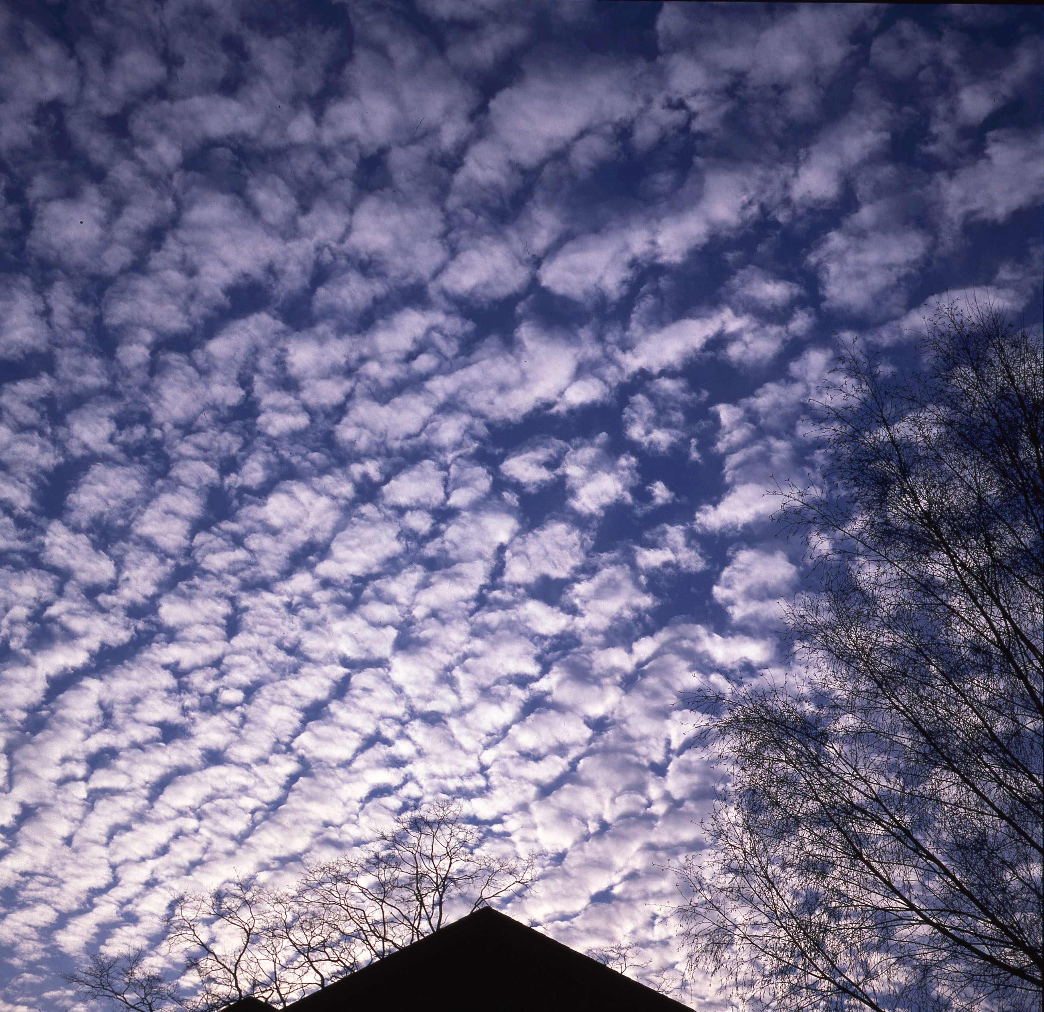
Altocumulus

Slide 24
Low Clouds (0-2 km)

Slide 25
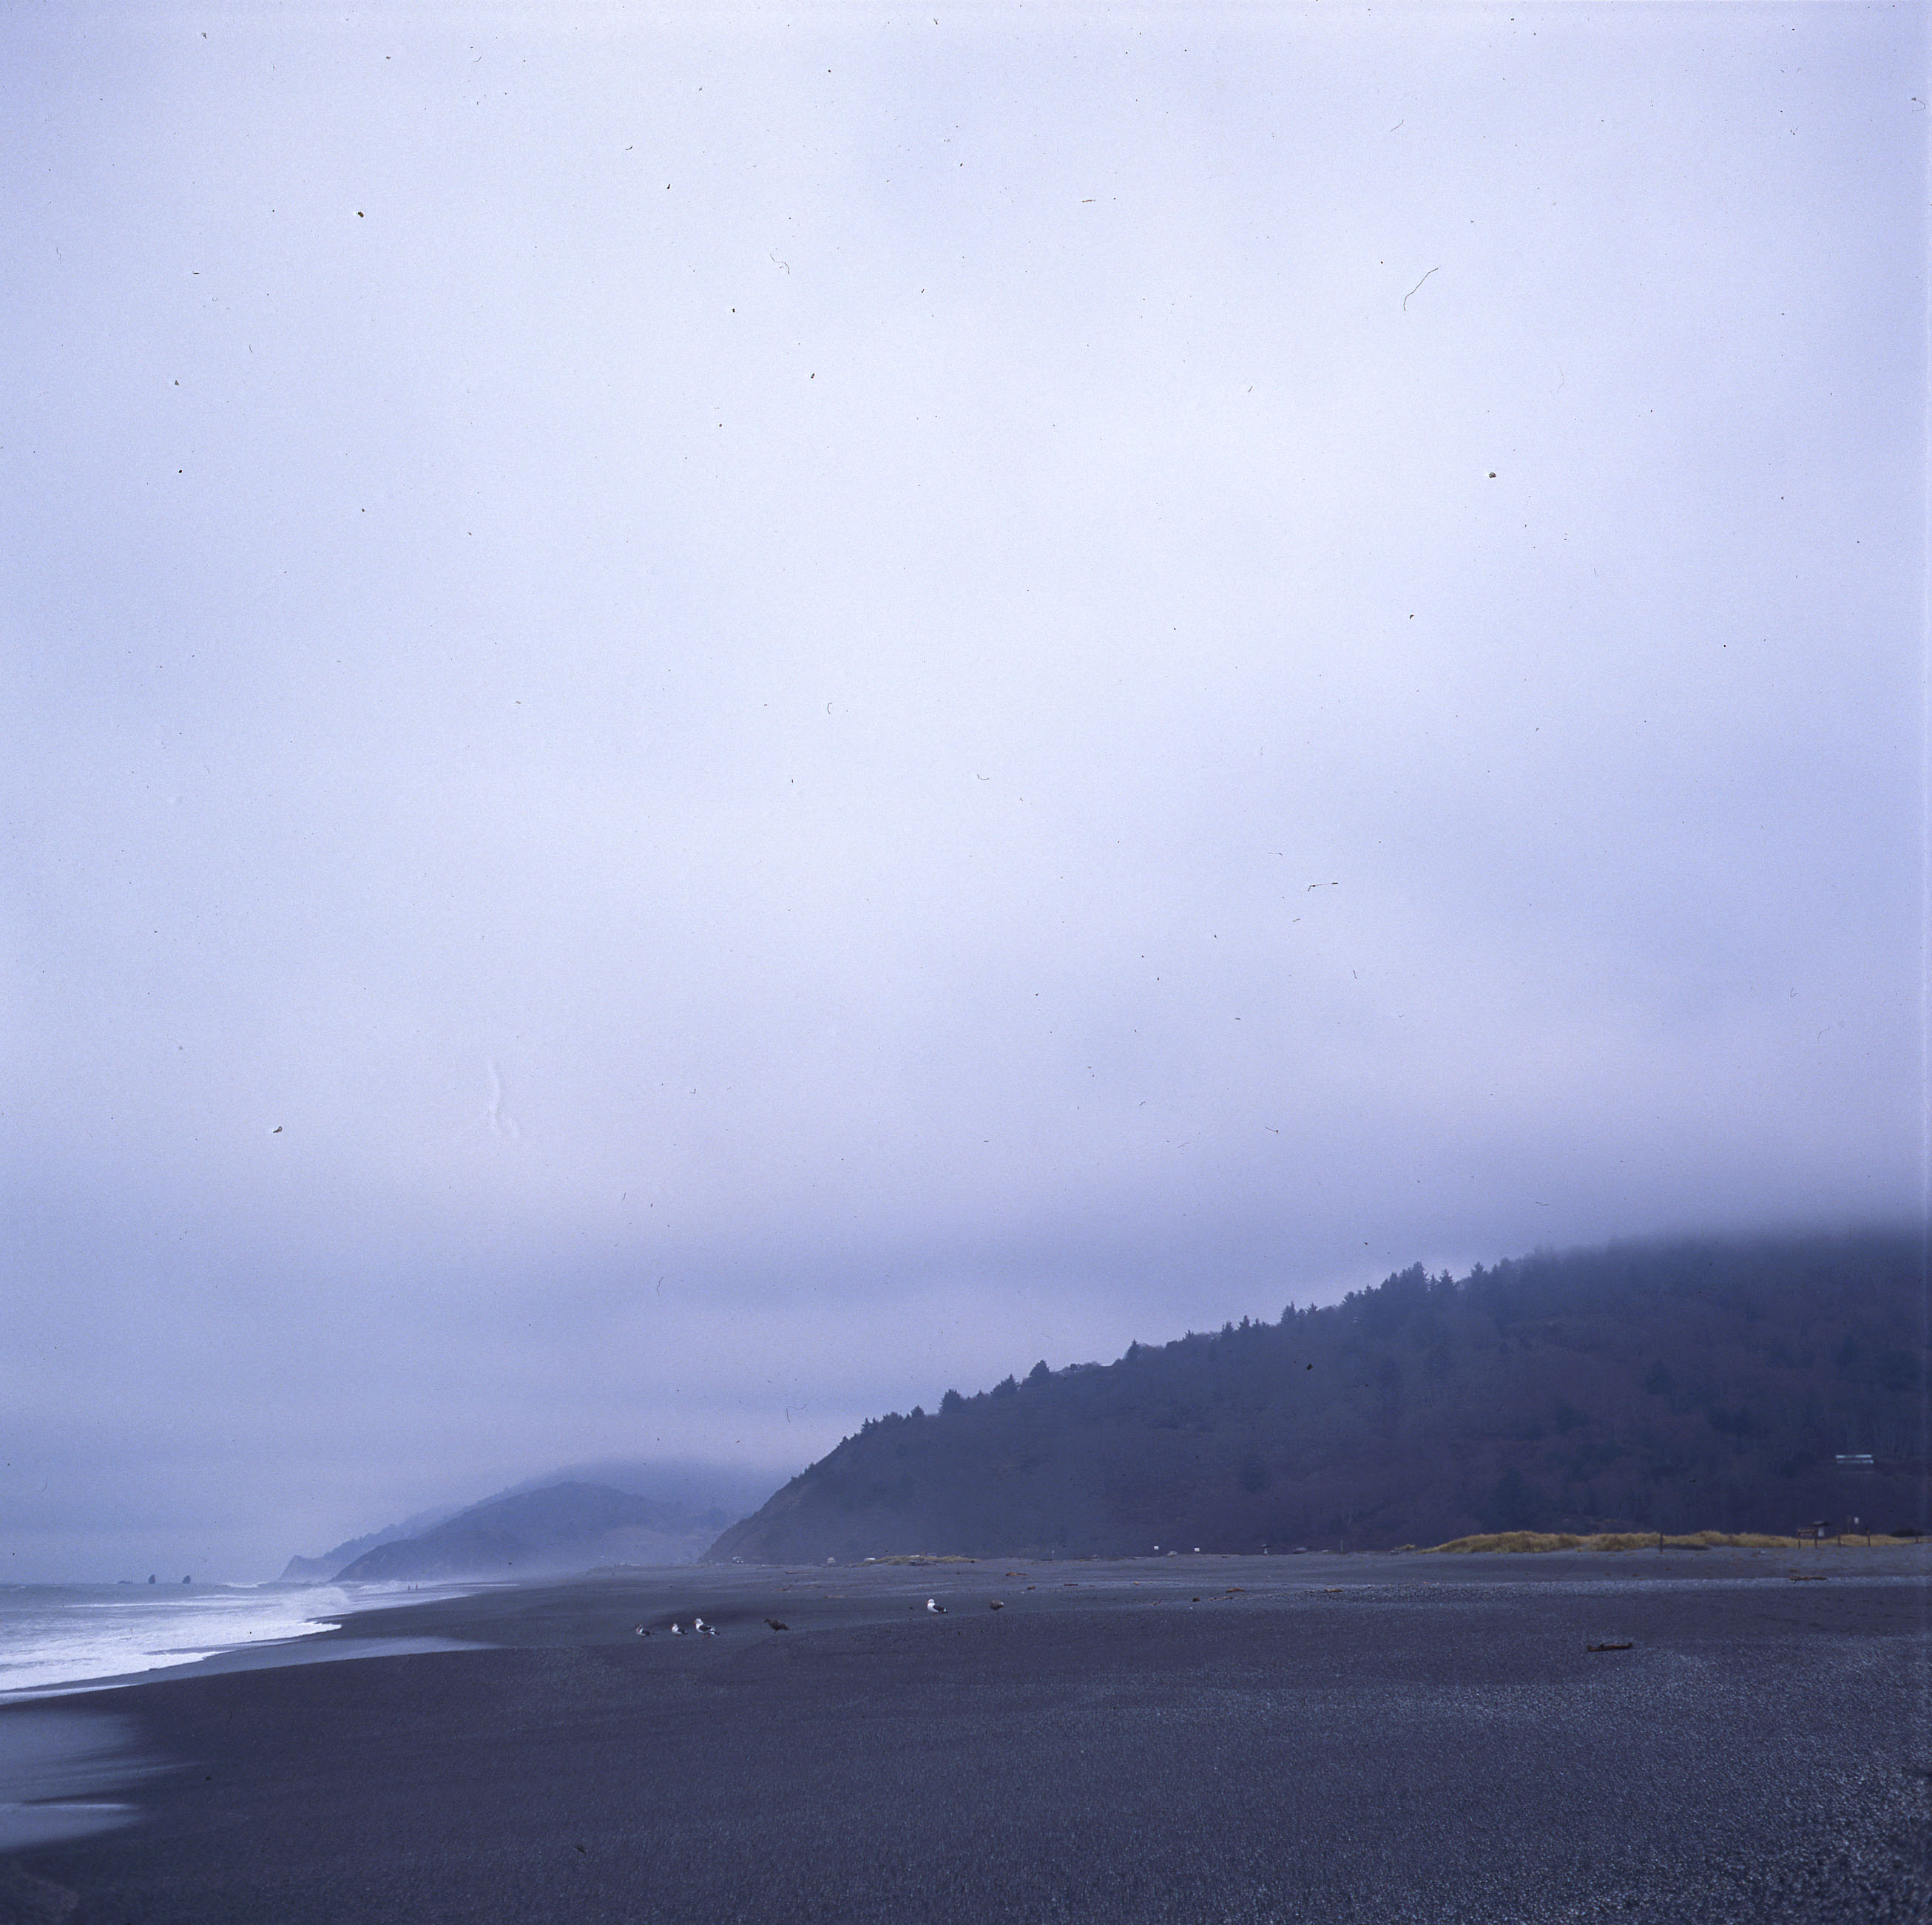
Stratus- nearly uniform layer

Slide 26
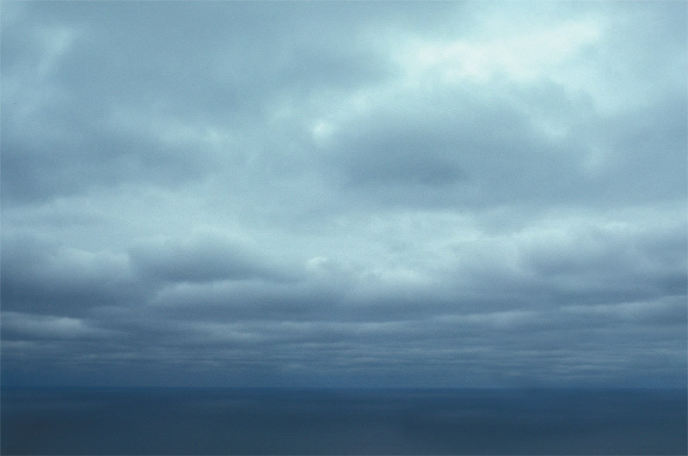
Stratocumulus- low and broken into elements

Slide 27
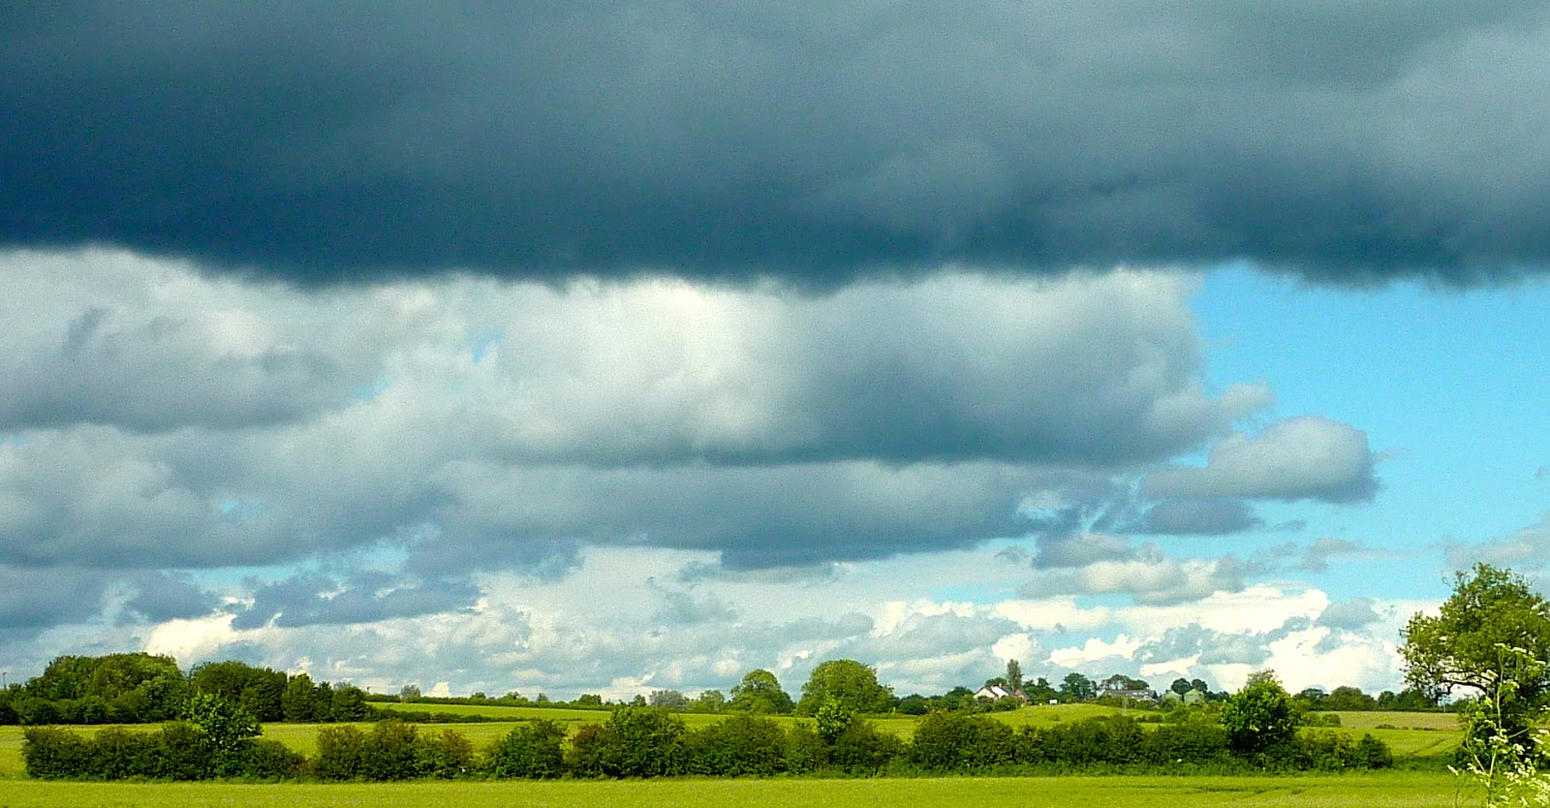
stratocumulus

Slide 28
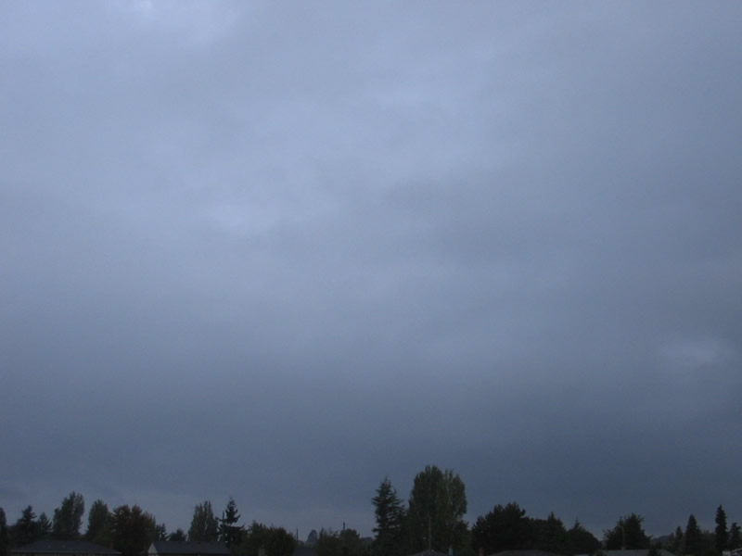
Nimbostratus—low, layered, and raining

Slide 29
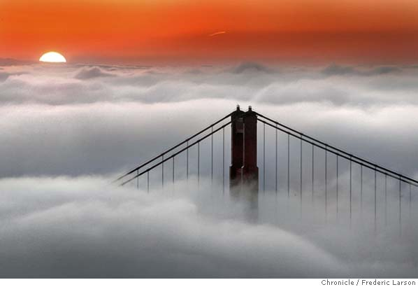
Fog

Slide 30
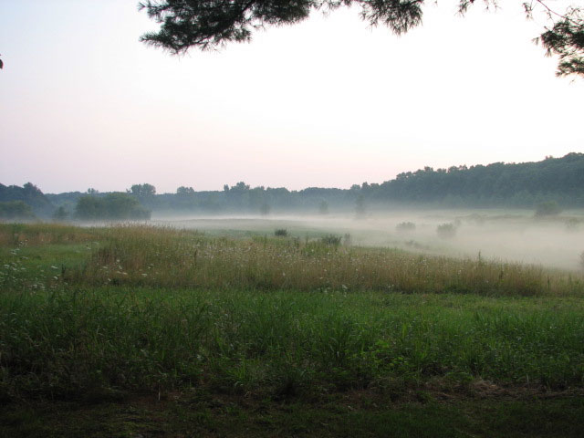
Ground fog

Slide 31
Clouds with vertical development
Cumulus, Cumulus Congestus, Cumulonimbus

Slide 32
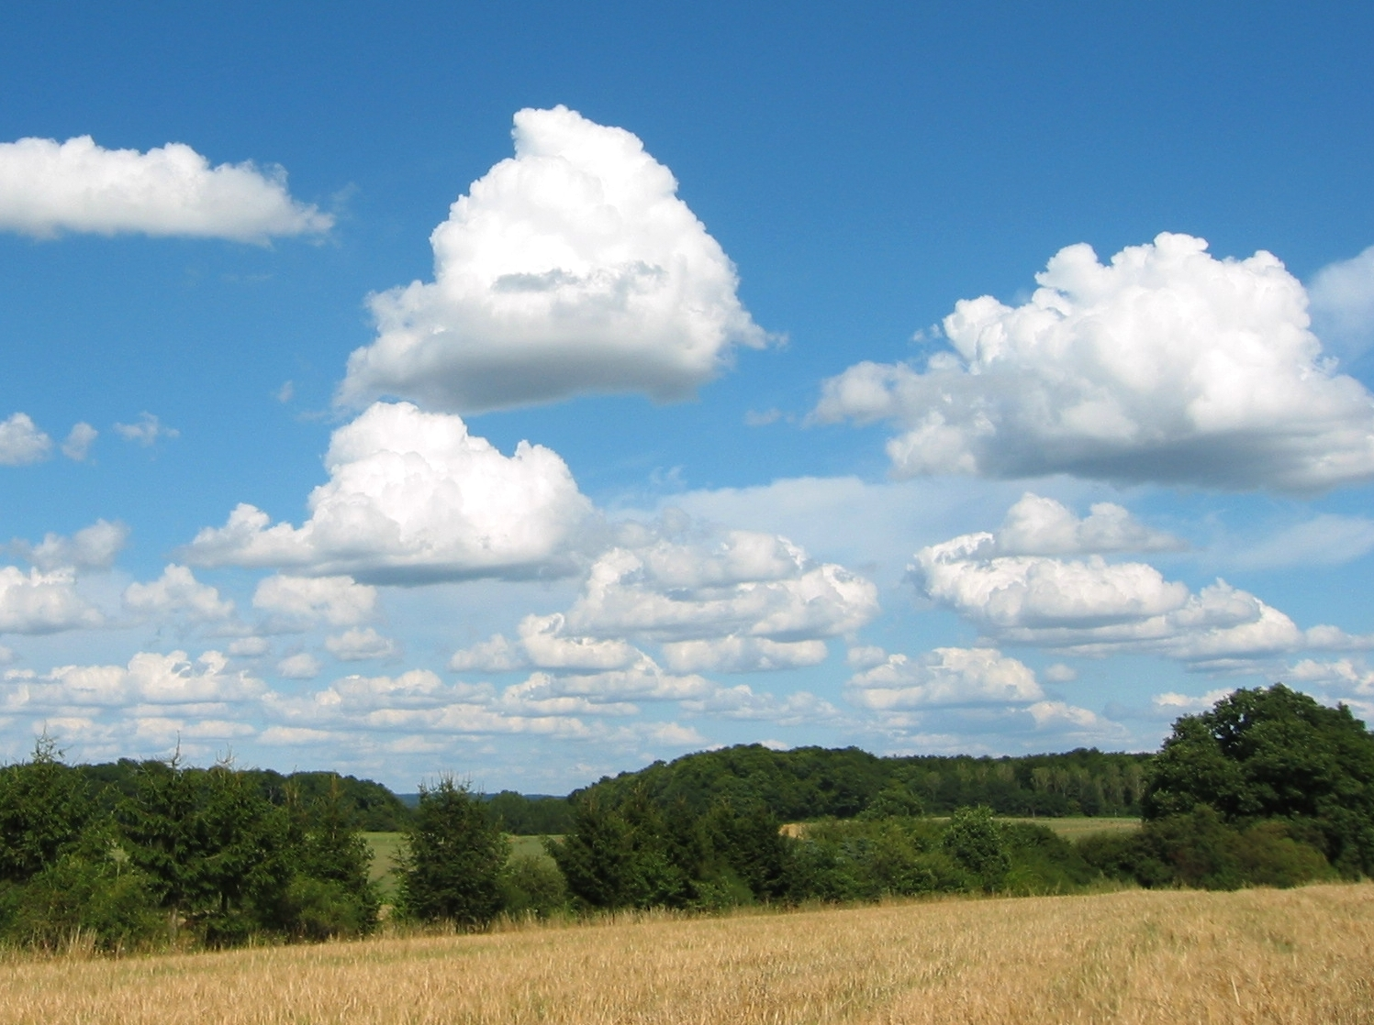
Fair weather cumulus

Slide 33
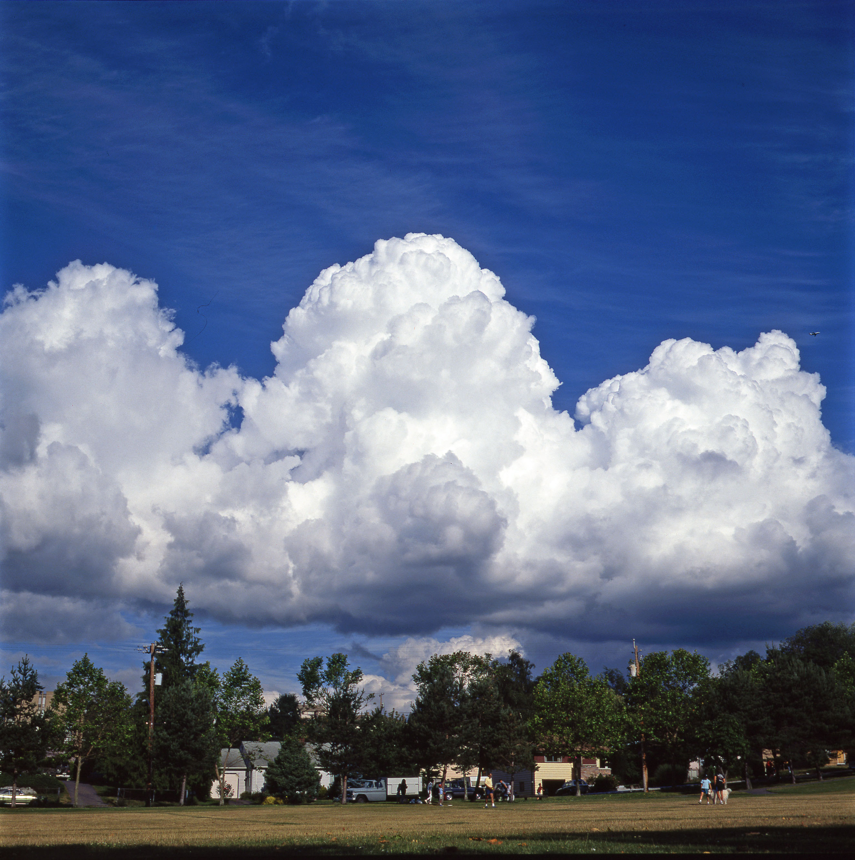
Cumulus Congestus: more vertical development
Note sharp
cloud edge: water cloud

Slide 34
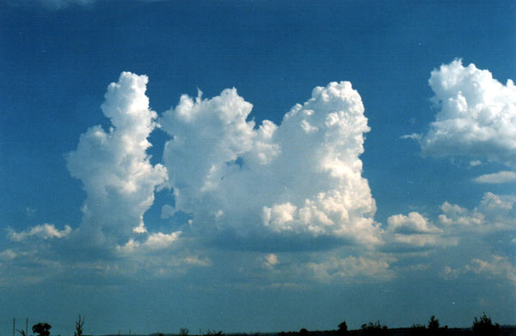
Cumulus Congestus

Slide 35
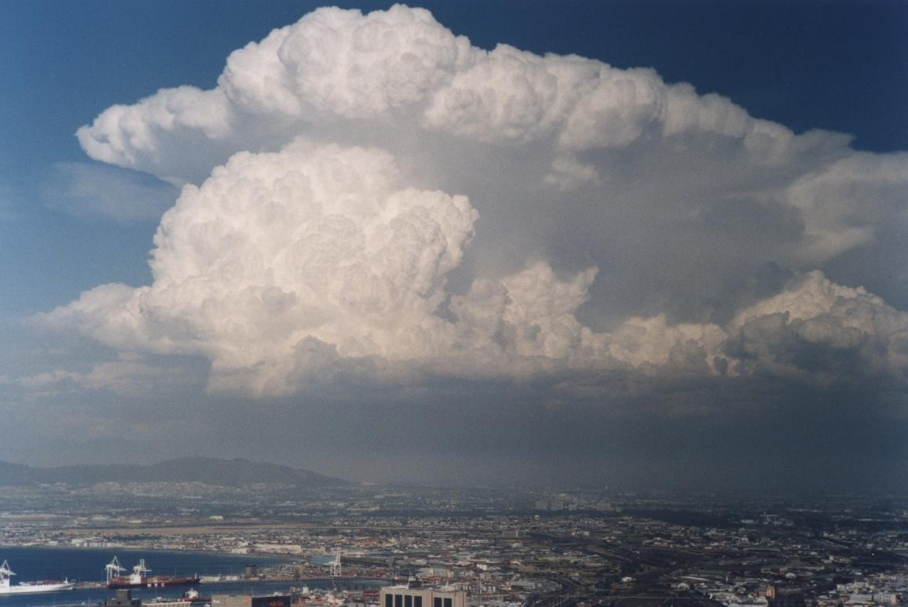
Cumulonimbus
Must be precipitating

Slide 36
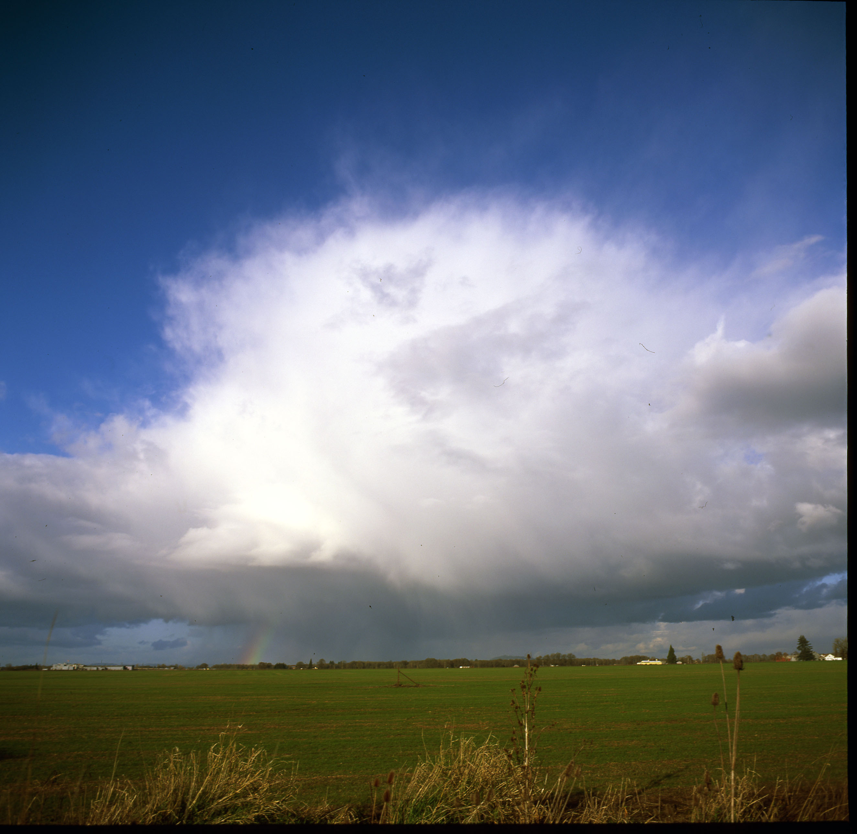
Cumulonimbus

Slide 37
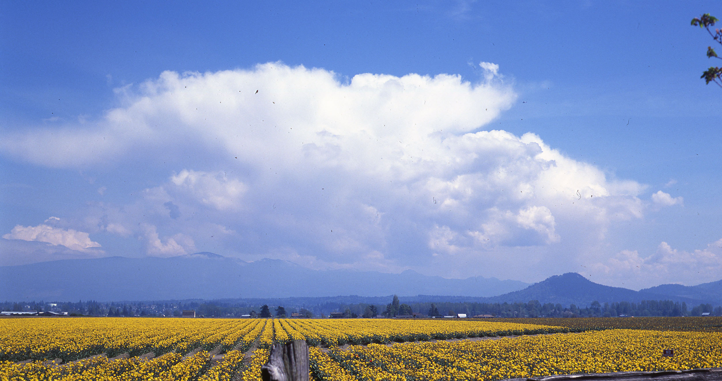
Cumulonimbus

Slide 38
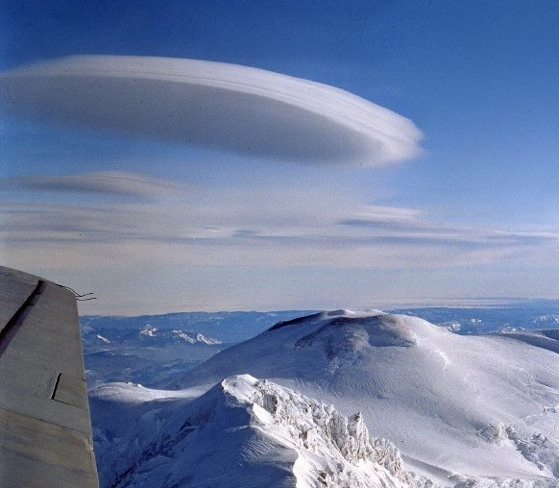
Lenticular or Mountain Wave Clouds
Altocumulus lenticularis

Slide 39
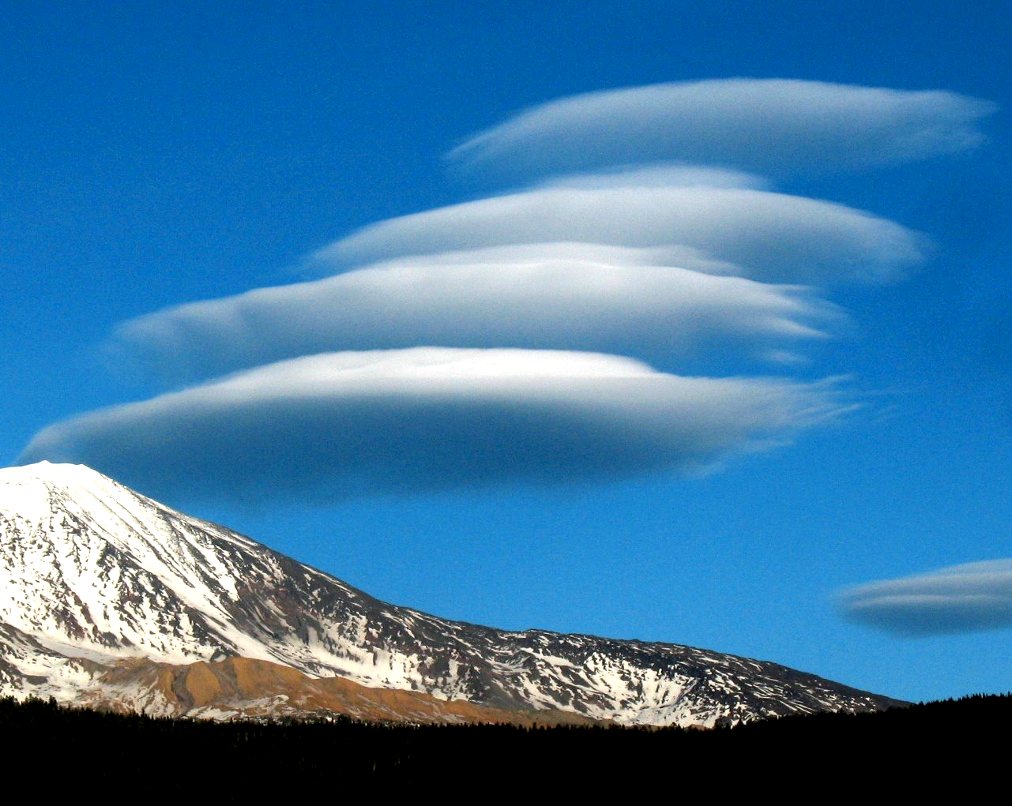
altocumulus lenticularis

Slide 40
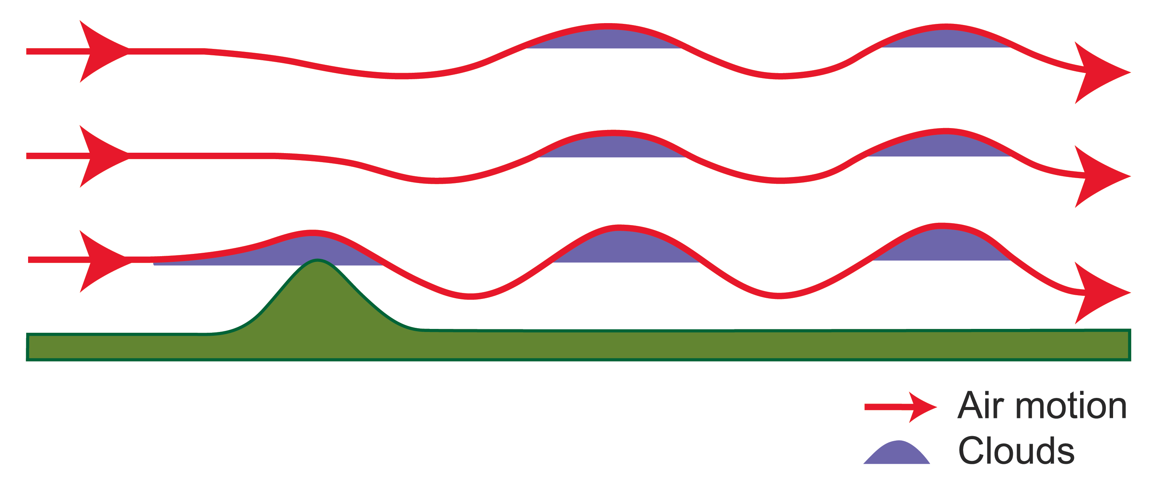
Mountain Wave Clouds

Slide 41
Believe it or not….
Lenticular Clouds and UFOs

Slide 42
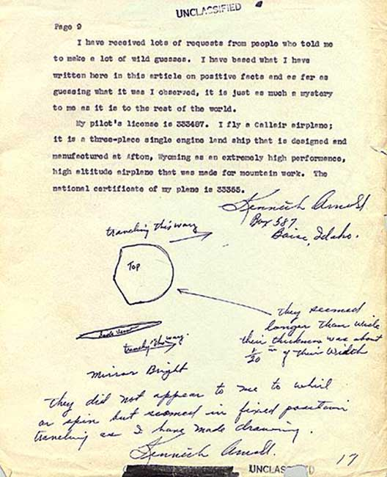
On June 24, 1947, Kenneth Arnold, flying a small plane between Chehalis and Yakima, spotted a group of “saucer-like” objects near Mt. Rainier

Slide 43

They were lenticular clouds. Thus, was born the UFO craze that continues until this day

Slide 44
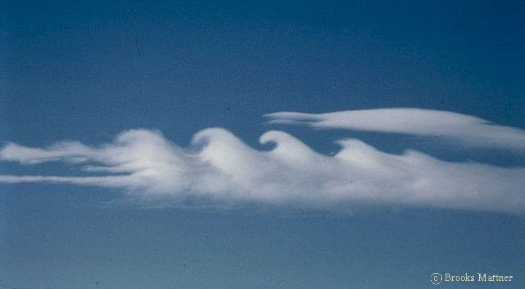
Kelvin-Helmholtz Billows
Kelvin-Helmholtz Instability Clouds
Associated with vertical wind shear. Atmosphere produces wave-like structures

Slide 45
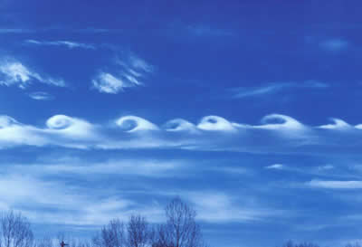
https://www.youtube.com/watch?v=qEGbzZM0Baw

Slide 46
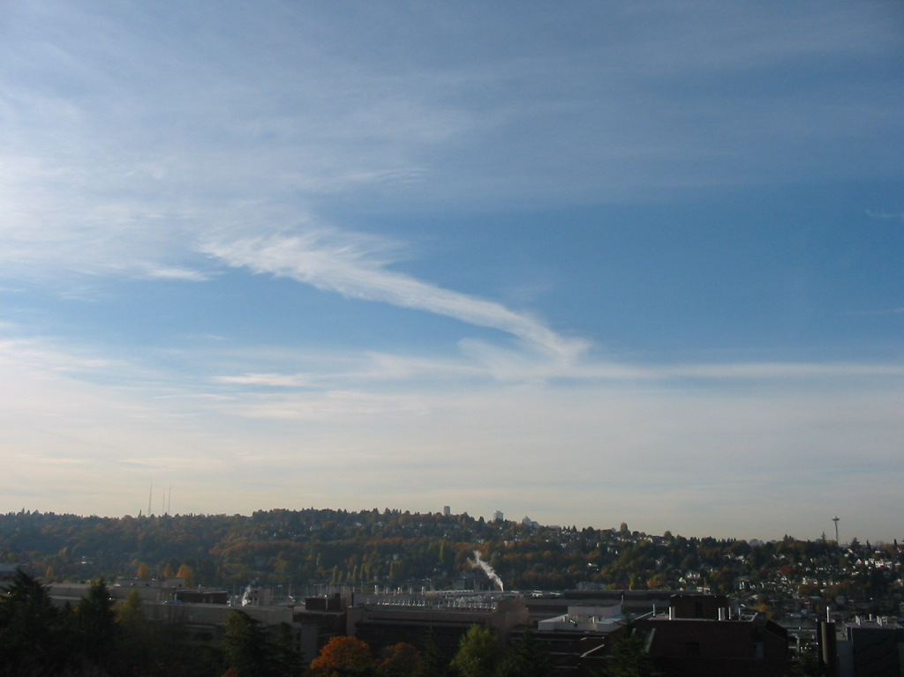
Contrails

Slide 47
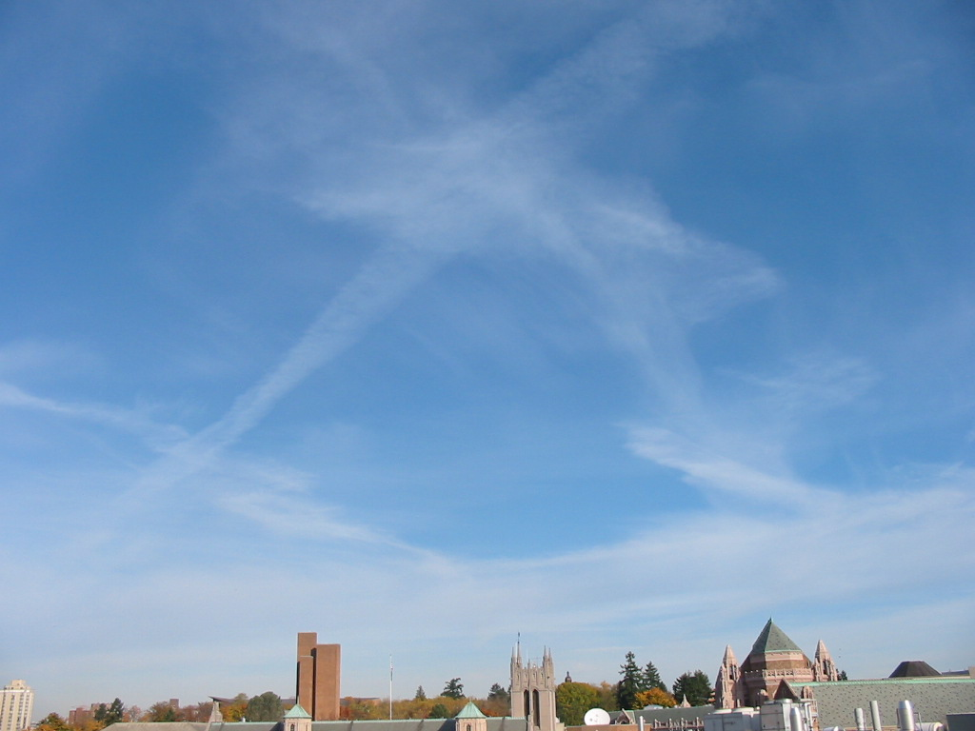

Slide 48
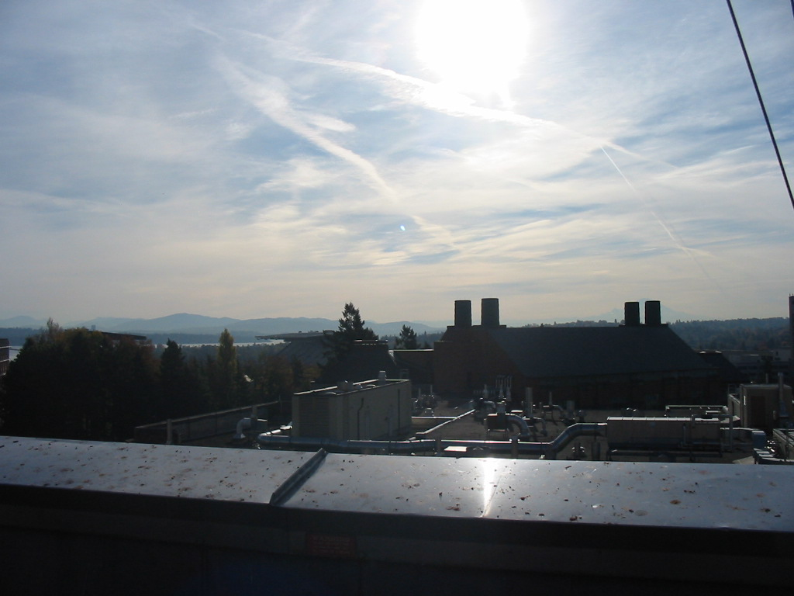

Slide 49
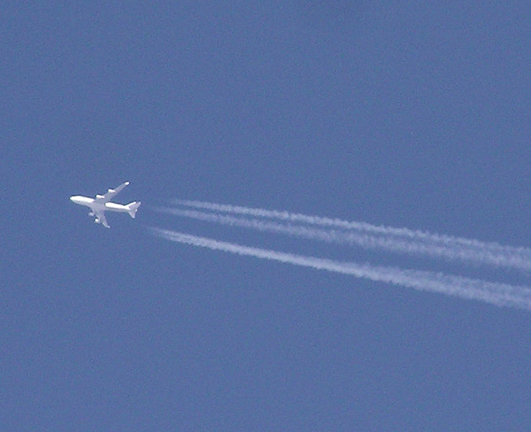

Slide 50
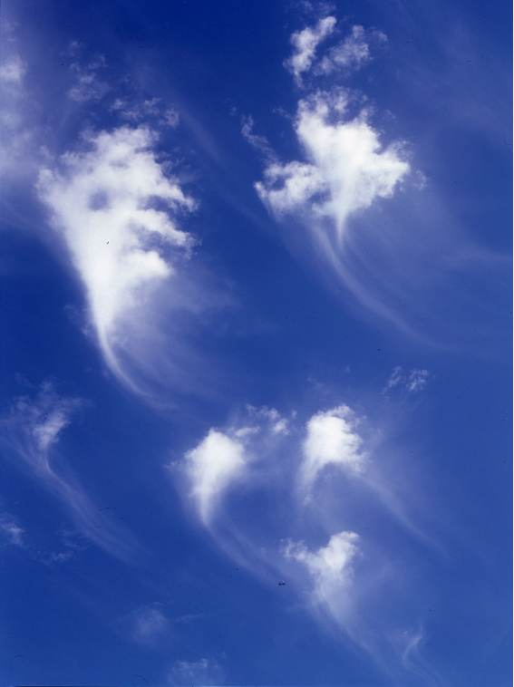
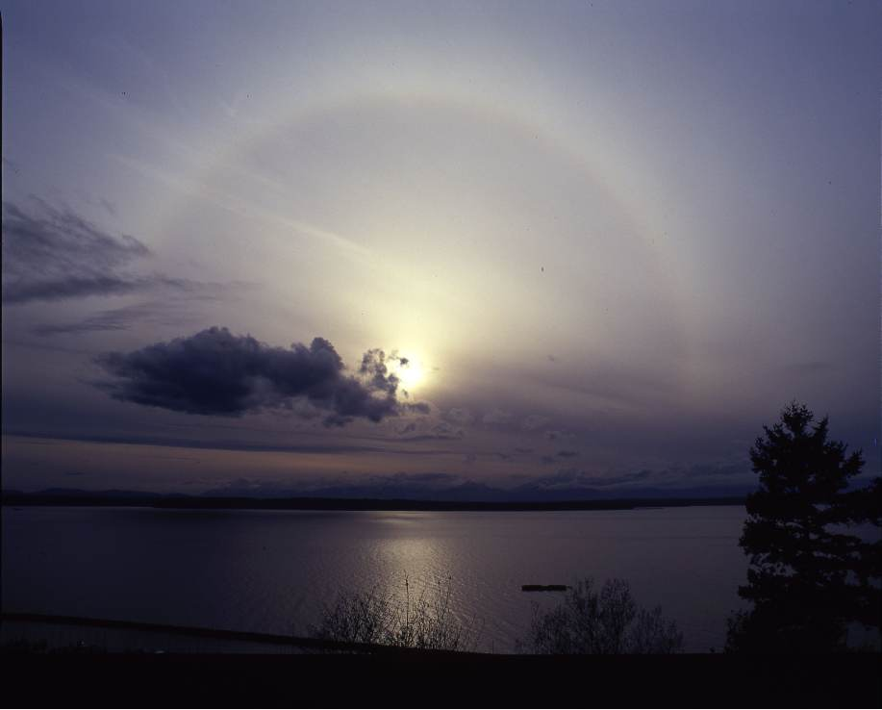
As fronts or storms approach there is a typical cloud progression with lowering and thickening of the cloud deck
Cirrostratus
Cirrus

Slide 51
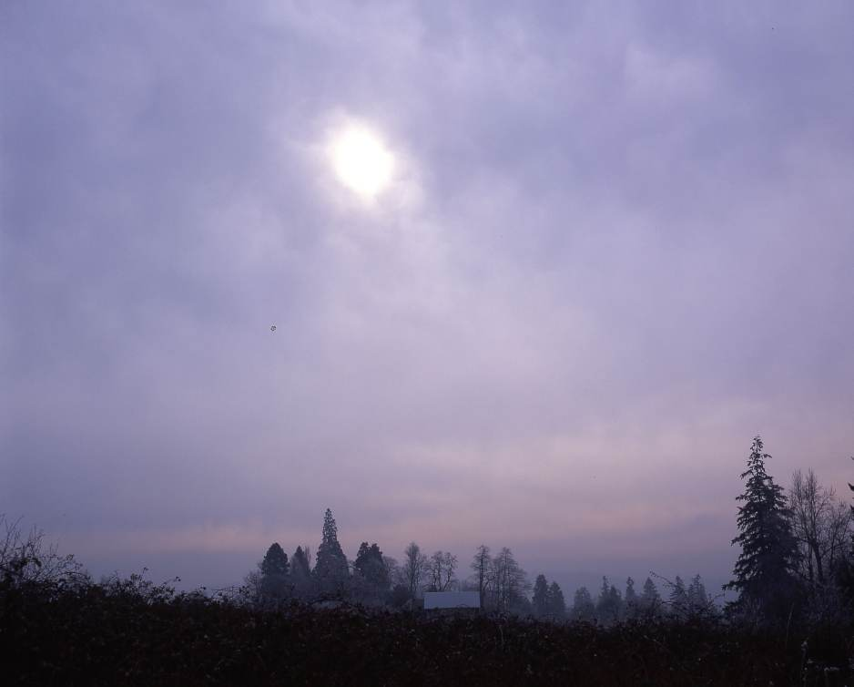
Altostratus: Watery Sun

Slide 52
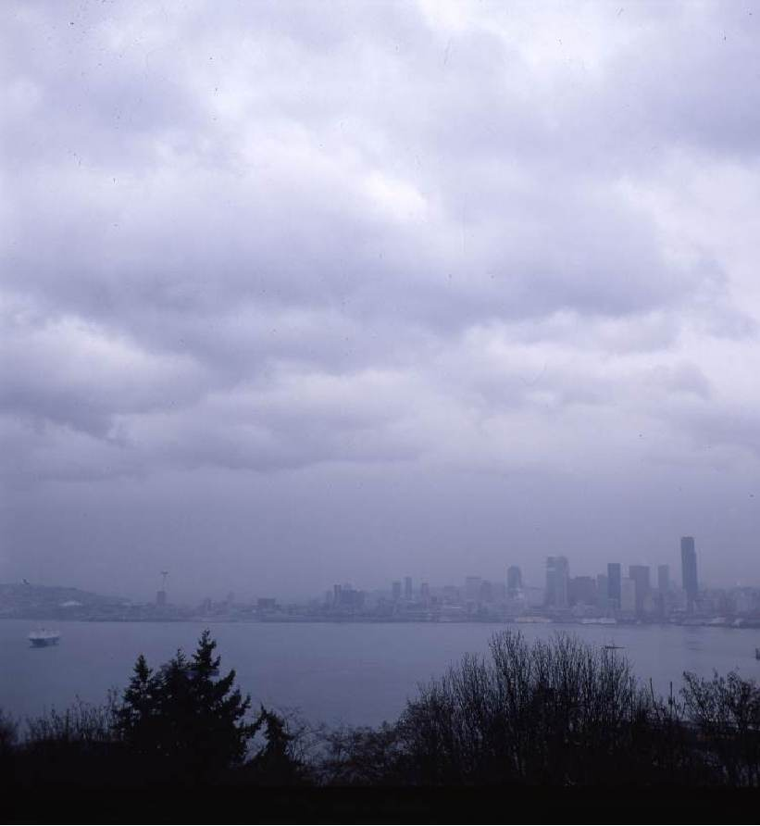
Nimbostratus

Slide 53
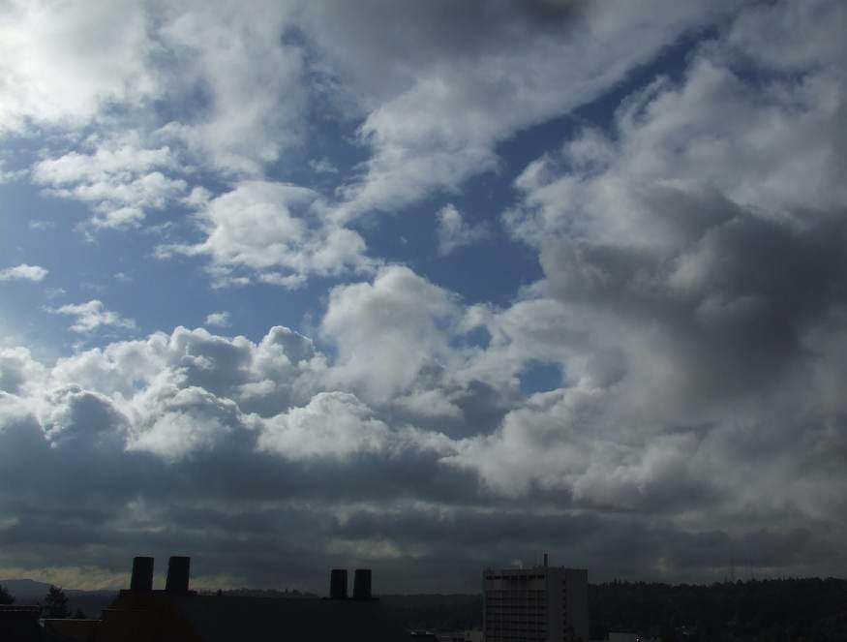
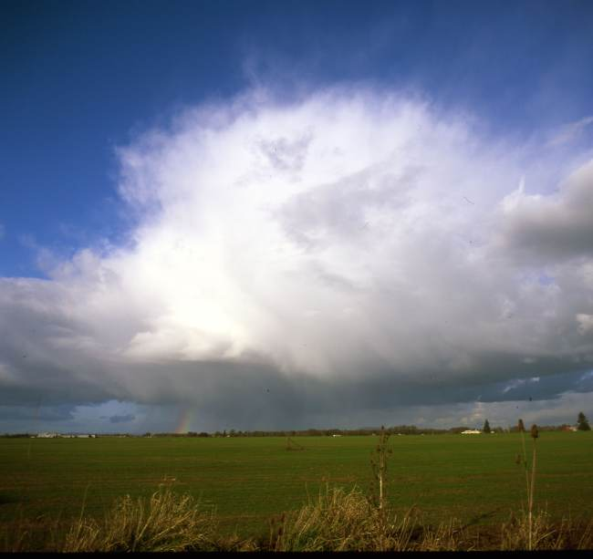
After the front: more cumuloform and instability clouds

Slide 54
Lenticular Clouds—often a sign of change. Higher relative humidity air moving in aloft. Front or storm may be approaching

Slide 55
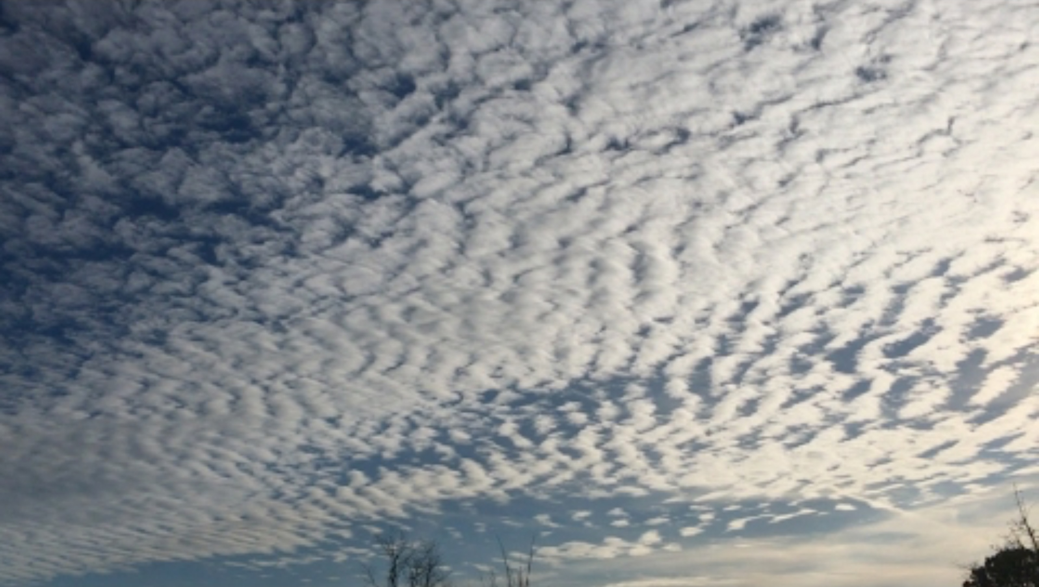
Cloud ID Video
https://www.youtube.com/watch?v=ce_x20pr_N0

Slide 56
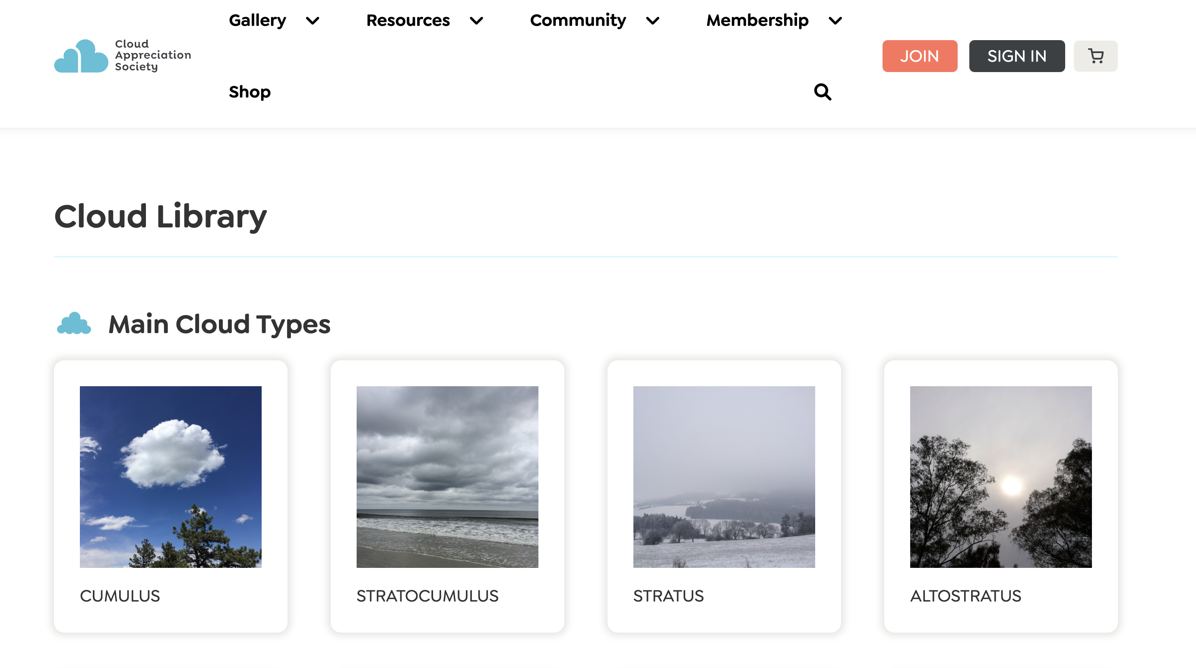
There is cloud chart available for the class
https://cloudappreciationsociety.org/cloud-library/

Slide 57
Test

